Slide 1


Key Phrases:
1. be the grandest occasion in the year : là dịp trọng đại nhất trong năm
2. Lunar New Year : Tết âm lịch
3. New Year : Tết dương lịch
4. used to be spread over months : đã từng kéo dài hàng tháng
5. build up well : xuất hiện/diễn ra mọi nơi
6. be decorated with … : được trang trí bằng …
7. be full of goods : có đầy đủ hàng hóa
8. with its ripe deep orange fruits : với những trái cam chín mọng
9. be popular throughout : phổ biến khắp nơi
10. be nice and polite to each other : tốt và lịch sự với nhau

Slide 2
Key Phrases:
11. exchange New Year's wishes : chúc tết
12. pray for a happy year for themselves: cầu mong một năm hạnh phúc cho chính họ

Slide 3
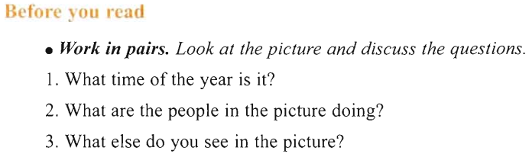
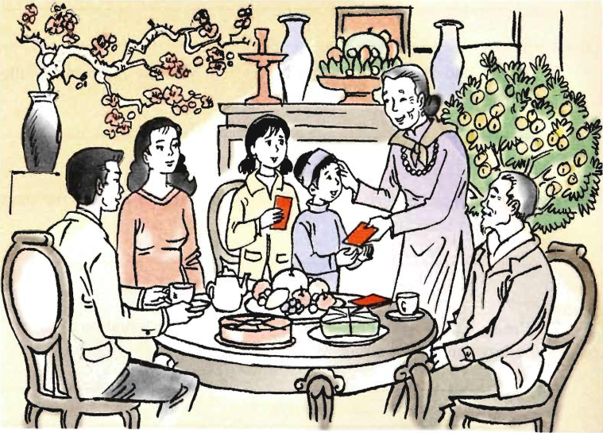

Slide 4

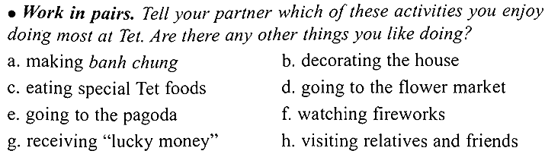

Slide 5


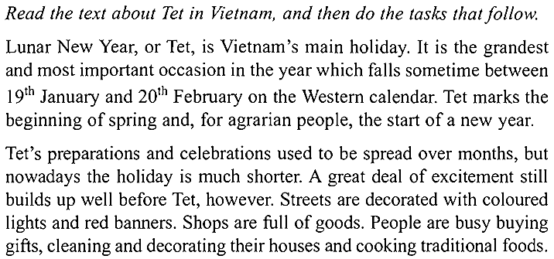

Slide 6
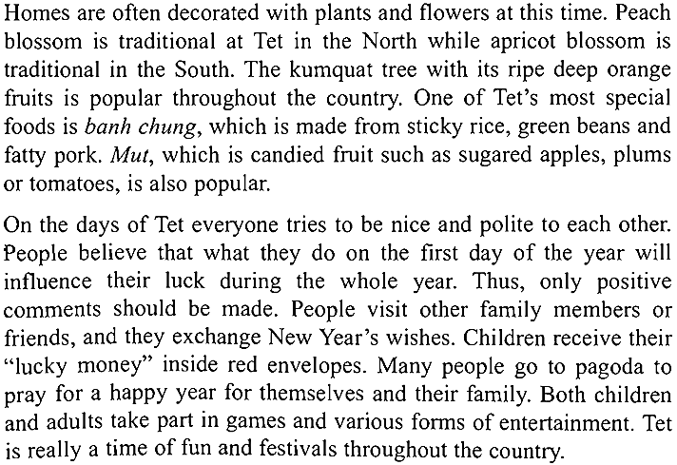

Slide 7
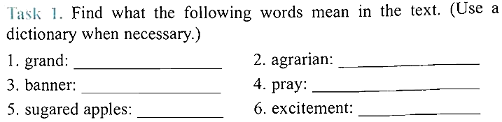
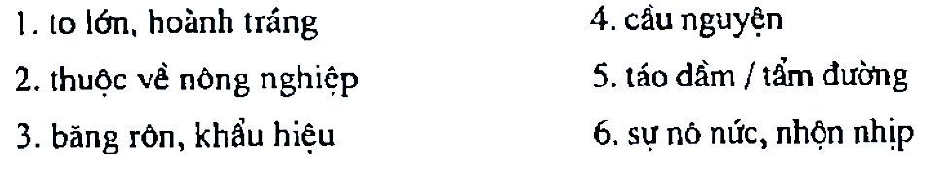

Slide 8
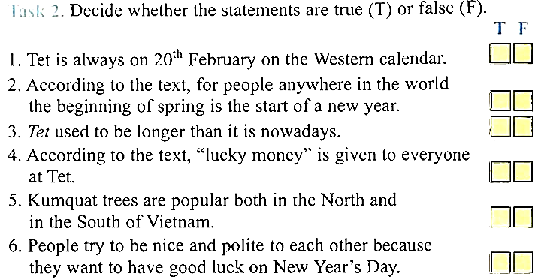







Slide 9
1. When is Tet holiday in Vietnam?
2. How long did Tet preparations and celebrations last in the past?
3. What do streets look like before Tet?
4. What do people often do to prepare for Tet?
5. What is banh chung made from?
6. What is mut?
7. What are some popular activities at Tet?
=> It's sometime between 19 January and 20 February.
=> They lasted for months.
=> They are decorated with coloured lights and red banners.
=> They buy gifts, clean and decorate their houses and cook traditional foods.
=> It's made from sticky rice, green beans and fatty pork.
=> It is candied fruit such as sugared apples, plums or tomatoes.
=> Visiting friends and other family members, exchanging wishes, going to the pagoda, playing games, etc

Slide 10
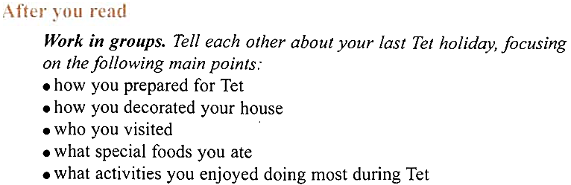
Suggestion answer: Last Tet holiday we did a lot of things. We went market to buy food, flowers, ... . We helped our parents with wrapping banh chung and cooking frozen meat. On the first day of Tet, we went to visit our grandparents and relatives, and we went to pagoda to pray for our family a happy year. During Tet days, we ate traditional foods such as banh chung, salted onions, ... . We enjoyed the gatherings of the family dinner on the New Year's Eve and meals on Tet days because it's the opportunity that ties our family relationship and makes us closer and closer. We also enjoyed playing some traditional games such as playing chess, playing on the swings, ... . We should remain Tet and preserve it.

Slide 11

Key Phrases:
1. do a big clean up : tổng vệ sinh
2. celebrate the New Year with … : đón năm mới cùng với …
3. New Year's Eve : Giao thừa
4. get rid of = remove : bỏ đi, loại bỏ đi, rũ bỏ đi

Slide 12
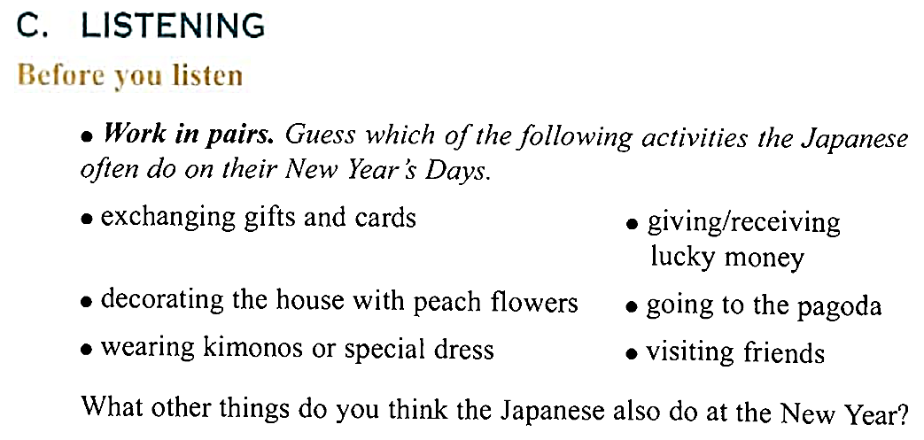

Slide 13
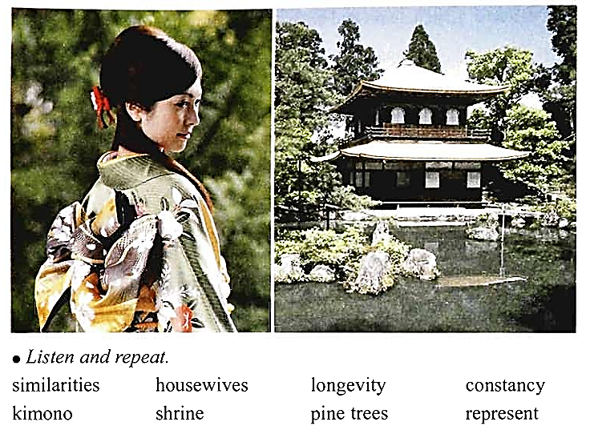

Slide 14
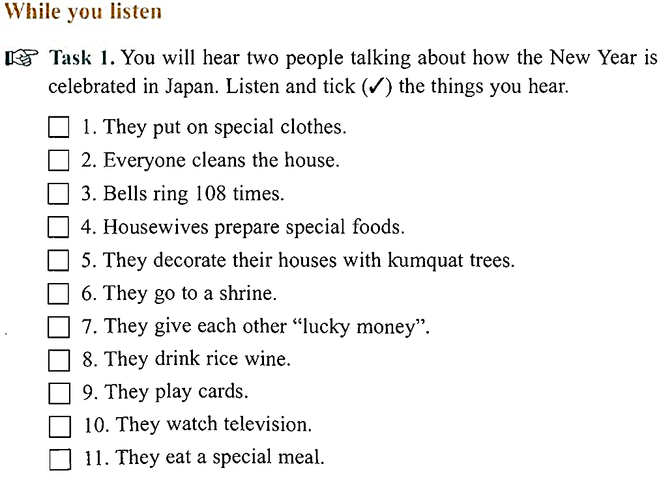









Slide 15
Task 2. Listen again and answer the following questions.
Why do the Japanese do a big clean up before the New Year comes?
2. Where do the Japanese hear the bells from?
3. What do the Japanese often wear when they go to visit their shrines?
4. Do the Japanese often celebrate the New Year with their friends?
=> Because they want to get rid of the dirt of the old year and welcome the New Year.
=> They hear the bells from television or the radio.
=> They often wear Kimonos or special dress.
=> No. New Year's Day is mostly celebrated among family only.

Slide 16
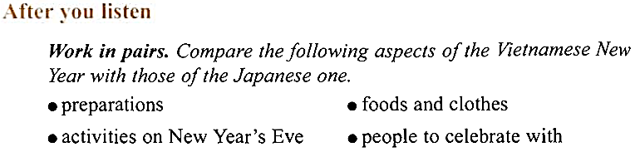
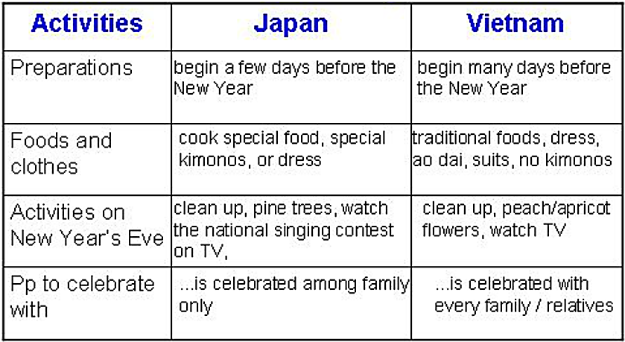
Suggestion answer:

